Slide 1
Booting from hard disk…
Starting Windos 2…
Press here to boot

Slide 2

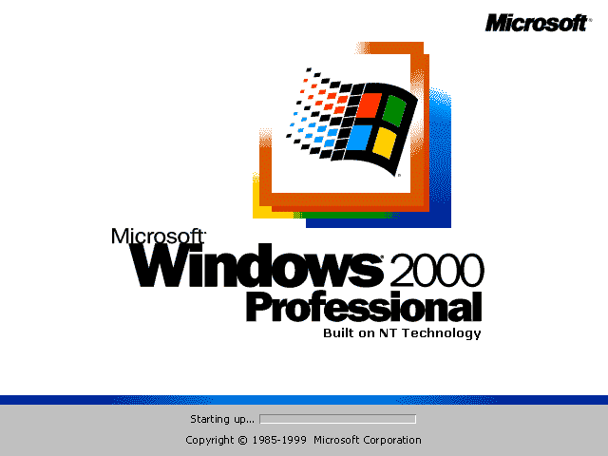

Slide 4
Memphis the virtual assistant is coming soon!
All apps
Computer
Run
Find ALPHA
Sign out
Power off
Windos 2.0
Click me to exit start menu

Slide 6
Minecraft

Slide 7
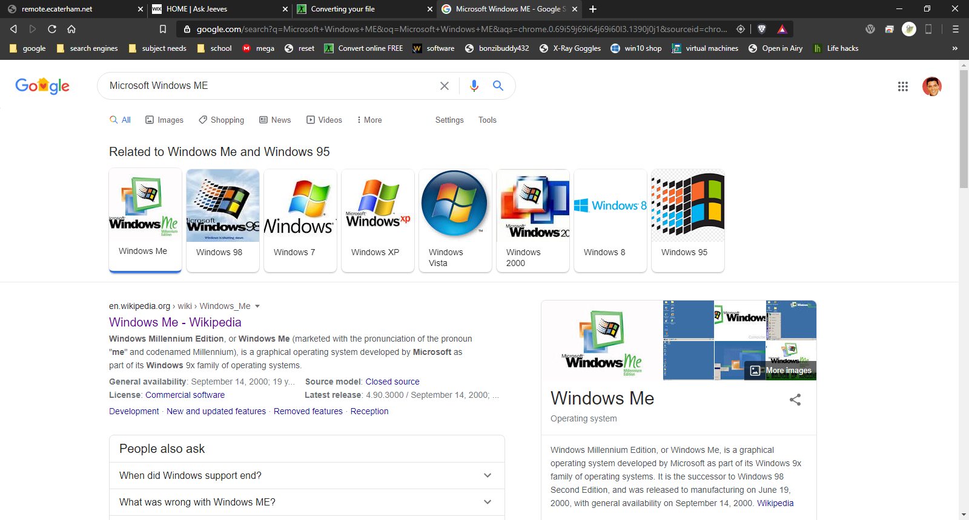
Googlee. Comm/search? Microsoft%Windows%ME=page1

Slide 8
Googlee. Comm. ukay
welcome to Googlee!
Search the intranet:
Click on the search bar for result
Microsoft Windows ME

Slide 9
Intranet Explorer CONNECTED TO NETWORK 1.128.256.666
Welcome to the Intranet!
Select a website to browse:
Ask Jeeves*
Googlee
MIME 1.01
*connects to internet site, outside of this VM

Slide 10
Intranet explorer
NO INTERNET
TAP HERE TO CONNECT TO THE INTRANET

Slide 11
Email 1.01
Inbox
Outbox
Sent items
Bin
Exit email
No emails in this folder

Slide 12
Browser 0.10
This browser has been discontinued in mid-development!
Open intranet explorer here:
link
About: hmm
No Intranet

Slide 13
Find ALPHA
File to find:
Windos. exe
Look in:
All drives
This is an alpha program.
You might not get anything!
Search now

Slide 14
C:\
Cannot view folder for some unknown reason.
Please check in the next update

Slide 15

Computer
C:\

Slide 16






All apps
Power menu
browser
email
antivirus+
Intranet explorer
Minecraft

Slide 18
inetwiz.exe
Connecting to the intranet
Please wait…

Slide 19
Find ALPHA result
Found:
C:\windos\system32\windos.exe
The file is 0.0001Mb in size and was created on : 23/04/2020
Open the file
exit

Slide 20
windos.exe
You cannot tun 2 instances of Windos at once, silly!
ok

Slide 21
Run
Enter the name of the program you wish to run, and Windos will run it for you:
Windos.exe
Run
Cancel

Slide 22

Power menu
Power off
restart

Slide 23
login
username
********
>

Slide 24
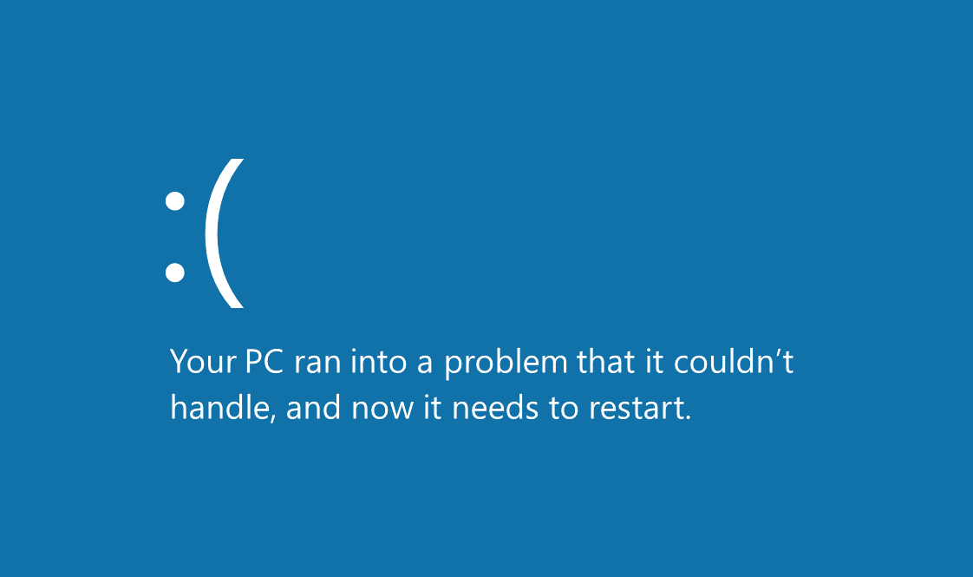

Slide 25


Windos 2
beta 2
For testing purposes ONLY
Shortcuts:
All apps
Computer
Browser
Email
What’s new:
Added start-up sound
Added intranet sites
Added new Clippy link
Updated browser from 0.09 to 0.10!
Added shortcuts widget!
Upgraded email program to
1.01
Announcement: this OS will exit beta soon!
Aligned watermark on desktop
Added Minecraft game
Hint of the version:
Don’t forget to check out the sites in Intranet Explorer!
They are added with almost every version!
Trash-can
start

